Slide 1
Crop Production Analysis in India
Gaurav Kumar Gautam

Slide 2
Introduction
India’s agriculture overview
Agriculture in India’s largest economic sector
Important in the development of the nation and economy due to its enormous size.
Rice and wheat are among the most important crops
Agriculture has a major portion of the Indian economy and employs a large section of society.
It is highly inefficient and unscientific
Problems can be solved by proper analysis of the agricultural data

Slide 3
Problem Statement
Finding trends in crops in terms of production, area, etc. over the years and studying the reasons behind the changing trends
Finding how different factors that affect production are related to each other
Study of crops that do not follow the general trends and show an abnormal trend such as a reduction in production
Finding similar crops and similar states based on various factors
Predictions of crops that might be rarely produced

Slide 4
Links
Python NoteBook:
https://colab.research.google.com/drive/1FqCfuR32wMAl9S6O0IsjSE1j195W7Xg9
Tableau Link:
https://public.tableau.com/views/CropProductionAnalysisinIndia1997-2014_16834028139020/cropvsprodandarea?:language=en-US&:display_count=n&:origin=viz_share_link

Slide 5
Data Cleaning
The data needed to be cleaned in the beginning. The challenges faced while cleaning the data are
The databases obtained were composed of data from different years, which were not the same across databases.
The names of some crops were not present in all the databases.
The database also contained a lot of missing data.
The data was of varying formats.
The naming conventions of crops and states were not the same across databases.
The units of measurement were different in different databases.

Slide 6
Exploratory data Analysis
Plotting the heatmap to check the correlation between each variable
Plotting the boxplot to check outliers
Then I did a bivariate analysis between two variables to know the production
Then I distributed the state between different zones
After that I applied pie chart and barplot on different crops to know the production and profits.

Slide 7
Observations
The highly produced crop in India is Sugarcane
India is the second-largest producer of this popular cash crop
Other crops which are highly produced in the country include rice, wheat, cotton, etc.
We can observe that most of the agricultural area in India is still depending on monsoon rainfall
Rainfall can have a direct or indirect impact on the area
From plots we can see a dependence between area and rainfall in the states like Bihar, Haryana, Madhya Pradesh, Rajasthan, and Telangana
Rainfall can affect the production of crops in a great way
From plots we can see in states like Chhattisgarh, Gujarat, Jharkhand, Karnataka etc(where the major crop is rice and sugarcane) increased rainfall is leading to increased production
In Haryana, Uttar Pradesh, Rajasthan(major crop is wheat) increased rainfall is showing to have negative impact on production

Slide 8
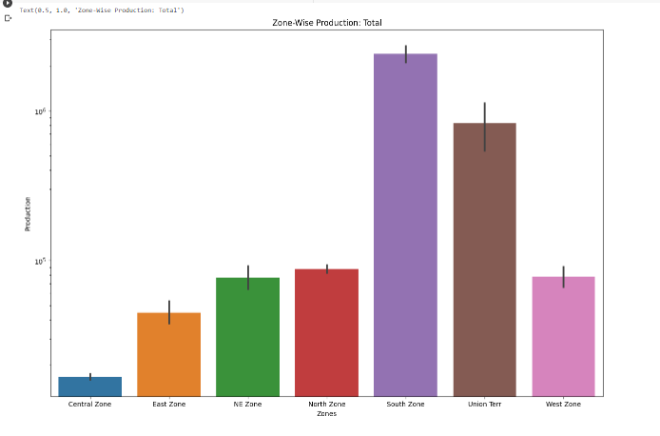
Zone-wise production, South-zone has a maximum production

Slide 9
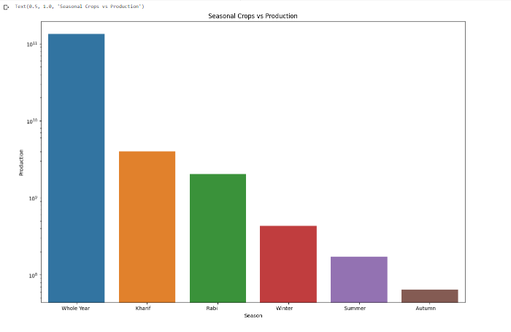
Seasonal Crops Vs Production

Slide 10

Different proportions of crops of India

Slide 11
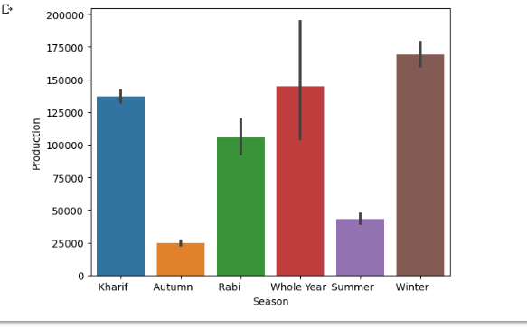
Production Vs Season

